Slide 1

PREDICTIVE ANALYSIS OF DIABETES STATUS USING MACHINE LEARNING MODELS
Team members
Naga Praneeth Cheela
Harish Kumar Sadasivam
Kiran Kumar Burlakunta
Thammi Babu Chattu
Anusai Muvvala

Slide 2
Introduction:
Diabetes Mellitus is a significant global health challenge, affecting an estimated 285 million people worldwide as of 2010, a figure projected to rise to 430 million by 2030 in the absence of improved interventions (Kaul et al., 2012).
Characterized as a chronic metabolic disorder, its increasing prevalence is primarily attributed to an aging population and the rising rates of obesity.
The disease manifests in various forms, each with its own set of complications, such as retinopathy, nephropathy, neuropathy, cardiovascular diseases, and diabetic foot, significantly impacting the immune system and overall health.
The chapter by Kaul et al. (2012) not only provides a comprehensive overview of the types and complications of diabetes but also delves into current management strategies, treatments, and emerging therapies, underscoring the complexity and multifaceted nature of this global health issue.

Slide 3

Aim of the Project
The objective of this project is to develop machine learning algorithms capable of precisely categorizing individuals as diabetic, pre-diabetic, or non-diabetic, using their health data. Such models will assist medical practitioners in recognizing those at potential risk for diabetes, enabling earlier diagnosis and prompt treatment.
This project aims to develop machine learning models that effectively distinguish between diabetic, non-diabetic, and pre-diabetic patients. By facilitating early diagnosis and timely treatment, these models aim to improve patient outcomes and quality of life. They will support healthcare professionals in pinpointing individuals at risk, allowing for tailored treatment strategies and more informed decisions regarding patient care. Additionally, this initiative seeks to contribute to public health by tackling the diabetes crisis, minimizing diabetes-related complications, and enhancing general health conditions.

Slide 4
Research Question
How do physiological markers, including blood sugar levels( HbA1C) and BMI, serve as reliable predictors of diabetes disease status in patients, and to what extent do demographic factors like age and gender fluence the likelihood of diabetes?

Slide 5
Research Hypothesis
Null Hypothesis:
Statistical analysis reveals no significant correlation between variables like age, urea, HbA1c, cholesterol, VLDL, BMI, and gender in determining whether an individual is classified as diabetic, non-diabetic, or pre-diabetic.
Alternate Hypothesis:
Statistical evidence indicates a significant correlation between variables including age, urea, HbA1c, cholesterol, VLDL, BMI, and gender in categorizing individuals as diabetic, non-diabetic, or pre-diabetic.

Slide 6
The dataset was obtained from the Medical City Hospital and the Specialized Center for Endocrinology and Diabetes at Al-Kindy Teaching Hospital in Iraq. Rashid, A. (2020). Diabetes Dataset. Data.mendeley.com, 1. https://doi.org/10.17632/wj9rwkp9c2.1
Categorical variables
Continuous variables
Gender
Diabetic status – Prediabetic-P
Diabetic-Y
Non-Diabetic-N
Age
Urea
Creatinine (Cr)
HbA1c
Cholesterol
Triglycerides (TG)
High-Density Lipoprotein (HDL)
Low-Density Lipoprotein (LDL)C
Very Low-Density Lipoprotein (VLDL)
Body Mass Index (BMI).

Slide 7
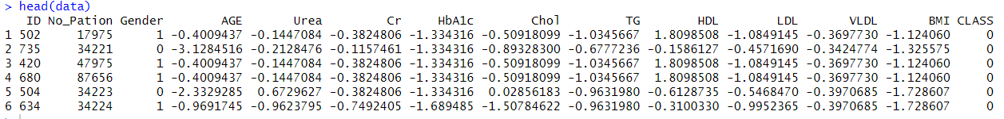
Data Storage: CSV files, R file
Models: Machine learning classifiers like Logistic Regression, was used.
Data Cleaning:
Data cleaning done by reading the CSV data file as the Data Frame
Data Encoding:
In this step, the 'CLASS' column in the dataset is transformed into numerical values, where 'Y' is coded as 1, 'N' as 0, and 'P' as 2. Simultaneously, the 'Gender' column is converted to numerical values, with 'F' and 'f' mapped to 1, and 'M' mapped to 0.

Slide 8

Missing values in the dataset :
No missing values in the dataset
Checking for duplicate values :
No Duplicate values found
sum(is.na(data))

Slide 9
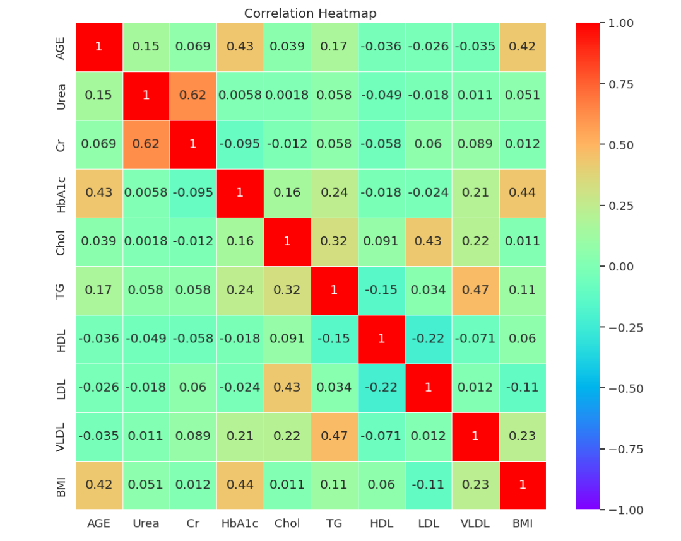
Correlation Heatmap for the Dataset.

Slide 10
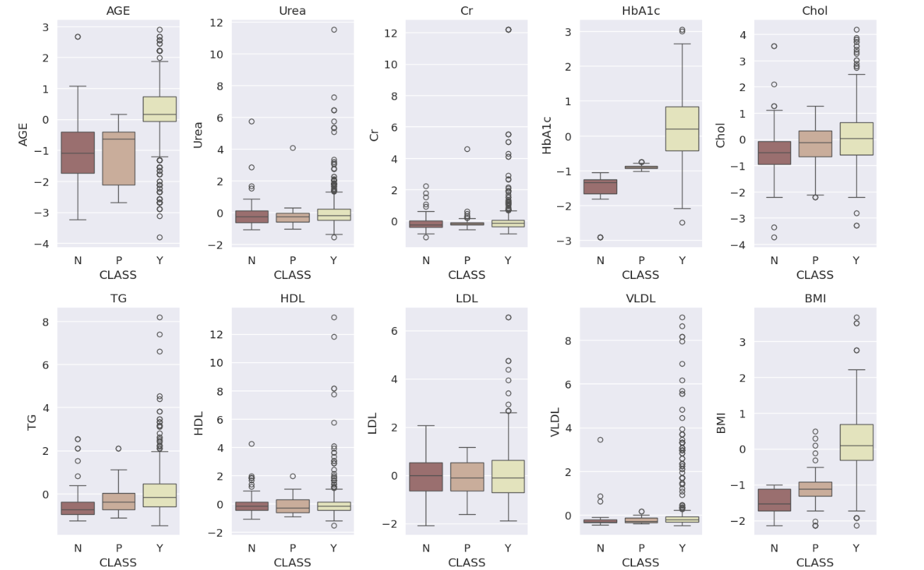
Checking for outliers using boxplot

Slide 11
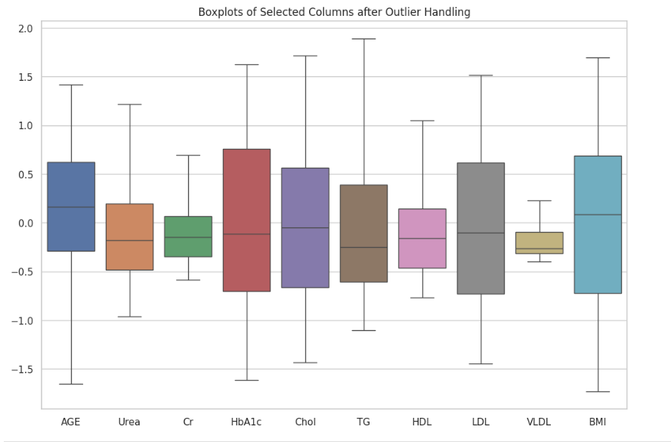
Replacing outliers with IQR(Interquartile range) -Boxplot

Slide 12
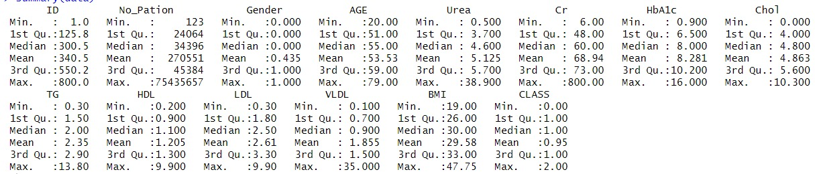
Summary Statistics of the Data

Slide 13
Histogram for BMI, HbA1c, Age
Specific Interpretations:
Distribution of BMI:
The right-skewed distribution suggests that a larger portion of the population falls within the healthy or overweight range (BMI 18.5-24.9 and 25-29.9, respectively), while a smaller percentage falls underweight (BMI < 18.5) or obese (BMI > 30).
Distribution of HbA1c:
This histogram shows a right-skewed distribution with a potential tail towards higher values. While the peak suggests a majority with HbA1c levels within the normal range, the tail indicates individuals who might be prediabetic or diabetic. HbA1c reflects long-term blood sugar control, and elevated levels are associated with diabetes and its complications.
Distribution of Age:
The right-skewed distribution suggests a focus on a middle-aged to older adult population. This aligns with the age groups most susceptible to chronic diseases like those potentially reflected in the other histograms.

Slide 14
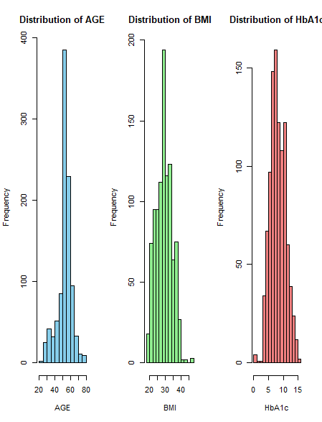

Slide 15
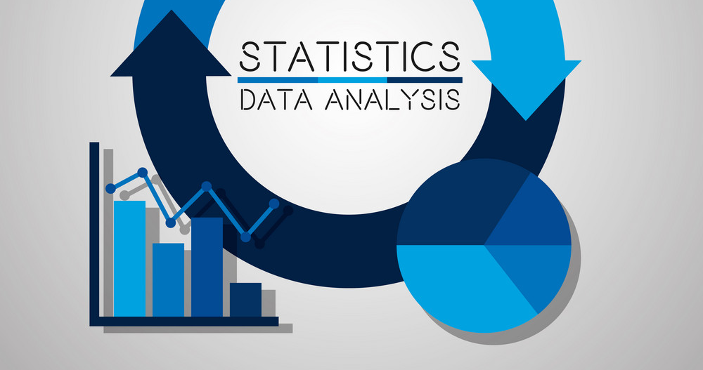

Slide 16
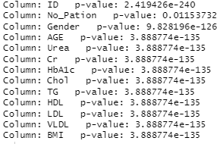
T-Test
T- test was performed between all the variables and target variable 'CLASS'.
The p-value obtained while comparing the variables is less than 0.05.
This reveals that there is statistical significant differences (p < 0.05) across all parameters. These findings underscore the potential significance of each variable in predicting diabetes, emphasizing their relevance in distinguishing between the two class categories.

Slide 17
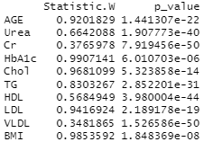
Shapiro-Wilk Test
Performed SHAPIRO-WILK on 10 variables
Variables considered are Age, Urea, Cr, HbA1c, chol, TG, HDL< LDL< VLDL, BMI
SHAPIRO-WILK TEST indicate all 10 variables deviate significantly from a normal distribution (P<0.05)

Slide 18
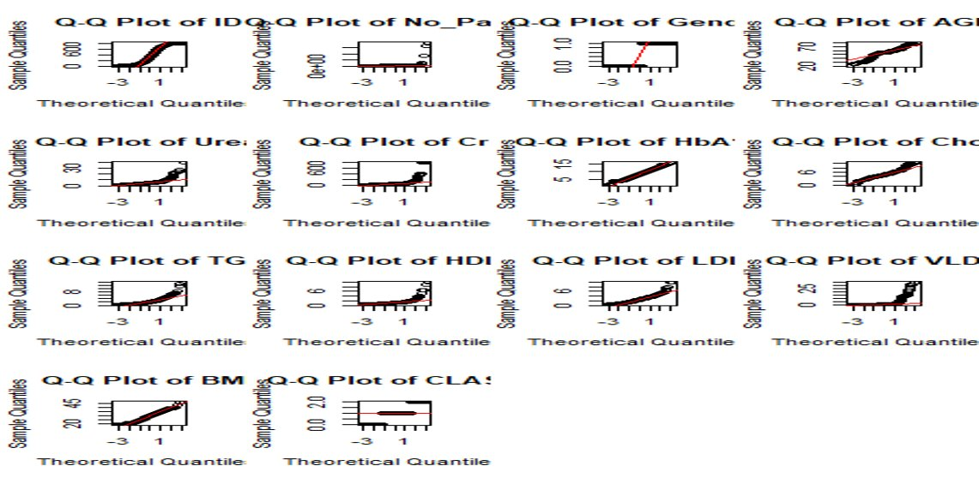

Slide 19

Chi- Square Test- Categorical Variables:
Tests association between categorical variables
Gender and class in this case
Test Statistic:
Chi-Square = 18.202
P-Value= 0.00011
Interpretation:
P-Value < 0.05 Threshold
There is a significant association between gender and class.
Result:
Since the P-value is lower than the 0.05 significance level
There is a link between gender and class
This provides evidence that gender and class variables are related based on distributions in the dataset.

Slide 20


Slide 21
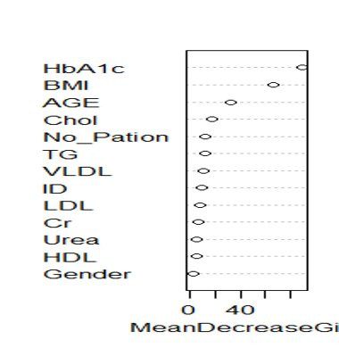
Feature Importance:
Feature importance in predictive modeling provides valuable insights into the contribution of each predictor variable to the model's predictive power. By quantifying the significance of each feature, we can prioritize the most influential variables, enhancing our understanding of the dataset and guiding more focused data collection and preprocessing.

Slide 22
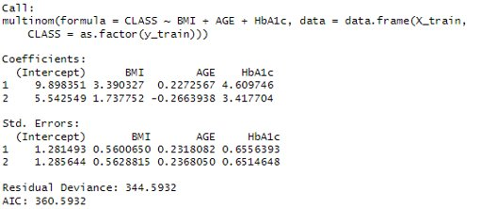
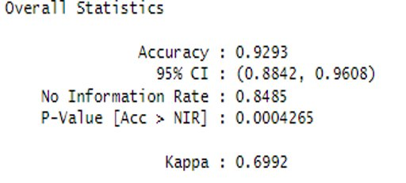
MULTIPLE LOGISTIC REGRESSION
In our study, we applied a multinomial logistic regression model to predict the outcomes based on three predictors: BMI, AGE, and HbA1c. The model's coefficients for Target variable (CLASS)are as follows: Intercept at 9.898, BMI coefficient at 3.390, AGE at 0.227, and HbA1c at 4.610.
Our confusion matrix results show an overall high accuracy of 92.93% in predictions, with a 95% confidence interval ranging from 88.42% to 96.08%. The Kappa statistic is 0.6992, suggesting a substantial agreement between predicted and observed classifications
In summary, the model demonstrates a high level of accuracy, particularly in predicting Target variable (CLASS).
For Target variable (CLASS), the coefficients are slightly different, with the Intercept at 5.543, BMI at 1.738, AGE at -0.266, and HbA1c at 3.418.

Slide 23
LIMITATIONS
Biased Data: The effectiveness of these statistical techniques hinges on the integrity of the data utilized. Should the data be tainted with bias or be incomplete, the outcomes derived may not precisely represent the actual interplay among the variables.
Size of Data: The adequacy of the dataset size is a critical factor that can limit the robustness of statistical analysis. If the dataset is too small, it may not capture the full variability or complexity of the underlying phenomena, leading to unreliable or non-generalizable results.

Slide 24
CONCLUSION
Both the two-sample t-test and Shapiro-Wilk test reveal a significant association between all variables and the target variable.
A Chi-square test is employed for categorical variables, highlighting a significant relationship between gender and the class variable.
Through the calculation of feature importance concerning the target variable, it is discerned that HbA1c, Age, and BMI emerge as the most influential variables affecting the target variable.
Utilizing a multiple logistic regression model to predict the 'CLASS' variable with HbA1c, Age, and BMI yields an impressive accuracy of 92.9%, suggesting a well-fitting model.
The small p-values from the Shapiro-Wilk and t-test outcomes provide substantial evidence to reject the null hypothesis. Consequently, we can assert that a meaningful association exists between the variables HbA1c, Age, BMI, and the target variable.

Slide 25
References
Kaul, K., Tarr, J. M., Ahmad, S. I., Kohner, E. M., & Chibber, R. (2012). Introduction to diabetes mellitus. Advances in Experimental Medicine and Biology, 771, 1–11. https://doi.org/10.1007/978-1-4614-5441-0_1
Rashid, Ahlam (2020), “Diabetes Dataset”, Mendeley Data, V1, doi: 10.17632/wj9rwkp9c2.1

Slide 26


